Slide 1
Introduction
Computer Networks (CSE3711)
Al-Sakib Khan Pathan, PhD
Senior Member of IEEE, USA
Professor, CSE, United International University (UIU), Bangladesh
[Slides modified from the original ones]
[Sources:
- Behrouz Forouzan, Data Communications and Networking. McGraw-Hill Science/Engineering/Math, ISBN-13: 978-0073250328, 4th edition (February 9, 2006)
- Mohssen Mohammed and Al-Sakib Khan Pathan. Automatic Defense against Zero-day Polymorphic Worms in Communication Networks. ISBN 9781466557277, CRC Press, Taylor & Francis Group, USA, 2013.]
1.<number>
Notes:
1.#

Slide 2
1-1 DATA COMMUNICATIONS - Recap
The term telecommunication means communication at a distance. The word data refers to information presented in whatever form is agreed upon by the parties creating and using the data. Data communications are the exchange of data between two devices via some form of transmission medium such as a wire cable.
Topics discussed in this section:
Components of a data communications system
Data Flow
1.<number>
Notes:
1.#

Slide 3

Figure 1.1 Components of a data communication system
1.<number>
Notes:
1.#

Slide 4

Figure 1.2 Data flow (simplex, half-duplex, and full-duplex)
1.<number>
Notes:
1.#

Slide 5
1-2 NETWORKS
A network is a set of devices (often referred to as nodes) connected by communication links. A node can be a computer, printer, or any other device capable of sending and/or receiving data generated by other nodes on the network. A link can be a cable, air, optical fiber, or any medium which can transport a signal carrying information.
Topics discussed in this section:
Network Criteria
Physical Structures
Categories of Networks
1.<number>
Notes:
1.#

Slide 6
Network Criteria
Performance
  Depends on Network Elements
  Measured in terms of Delay and Throughput
Reliability
  Failure rate of network components
  Measured in terms of availability/robustness
Security
  Data protection against corruption/loss of data due to:
      Errors
      Malicious users
1.<number>
Notes:
1.#

Slide 7
_x0010_Physical Structures
Type of Connection
  Point to Point - single transmitter and receiver
  Multipoint - multiple recipients of single transmission
Physical Topology
  Connection of devices
  Type of transmission - unicast, mulitcast, broadcast
1.<number>
Notes:
1.#

Slide 8

Figure 1.3 Types of connections: point-to-point and multipoint
1.<number>
Notes:
1.#

Slide 9
Network Topology
Network topology means the pattern or the model by which various elements of a network are interconnected. The elements could be computers, switches, routers, hubs, printers, phones, and other communications devices. For the interconnection, a wireless or wired medium could be used.
Network topologies may be either physical or logical. Physical topology is defined by the physical design of a network, including the devices, location, and cable installation. Logical topology refers to how data are actually transmitted or circulated in a network.
1.<number>
Notes:
1.#

Slide 10
Network Topology …
Physical topology could be understood by examining the structure or formation of the network; however, for understanding the logical topology, we need to understand which path the data follow while traveling through the network links. In other words, physical topology is the actual visible model of the network, and logical topology is the conceptual connectivity pattern of the communications devices.
1.<number>
Notes:
1.#

Slide 11

Figure 1.4 Main categories of topology
1.<number>
Notes:
1.#

Slide 12

Figure 1.5 A fully connected mesh topology (five devices)
1.<number>
Notes:
1.#

Slide 13

Figure 1.6 A star topology connecting four stations
1.<number>
Notes:
1.#

Slide 14

Figure 1.7 A bus topology connecting three stations
1.<number>
Notes:
1.#

Slide 15

Figure 1.8 A ring topology connecting six stations
1.<number>
Notes:
1.#

Slide 16

Figure 1.9 A hybrid topology: a star backbone with three bus networks
1.<number>
Notes:
1.#

Slide 17
Physical and Logical Topologies Mixed
According to the book:
Mohssen Mohammed and Al-Sakib Khan Pathan. Automatic Defense against Zero-day Polymorphic Worms in Communication Networks. ISBN 9781466557277, CRC Press, Taylor & Francis Group, USA, 2013.
Let’s see …
1.<number>
Notes:
1.#

Slide 18
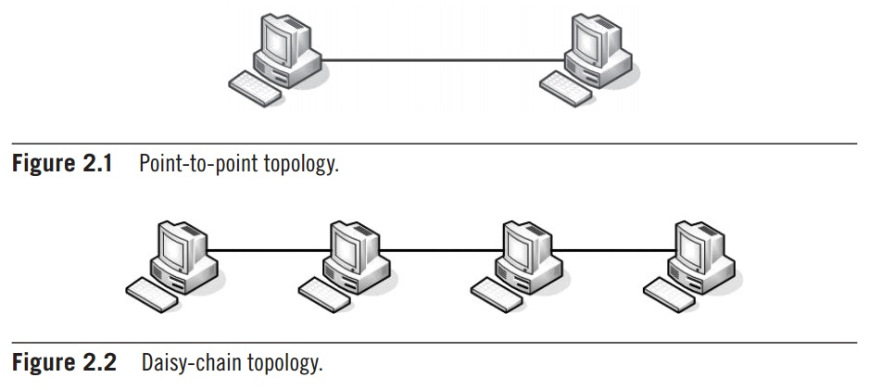
Figure PtP and daisy-chain
1.<number>
Notes:
1.#

Slide 19
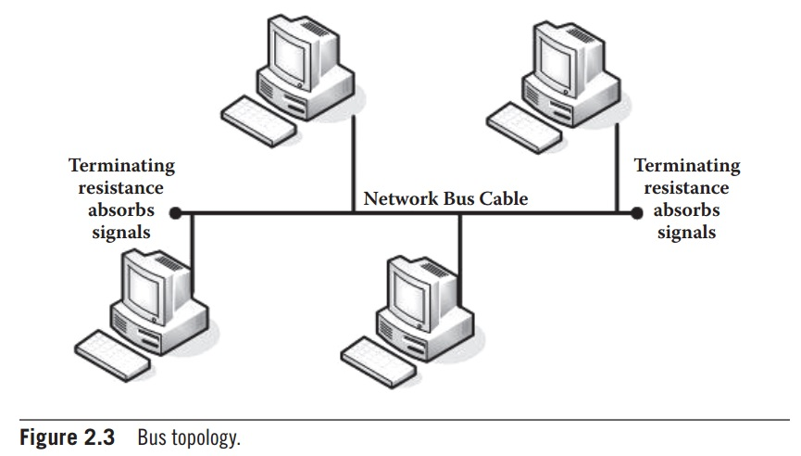
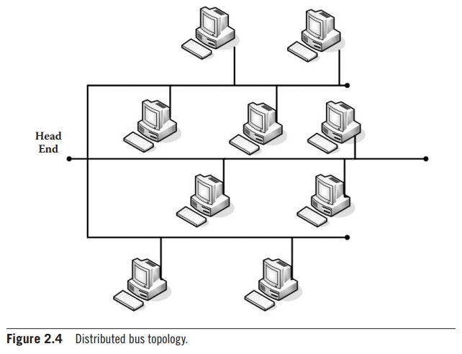
Figure Two types of Bus (Point-to-Multipoint) topology
1.<number>
Notes:
1.#

Slide 20
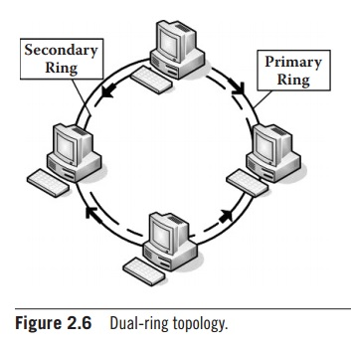
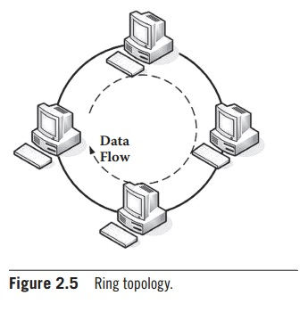
Figure Ring and Dual-ring topology
1.<number>
Notes:
1.#

Slide 21
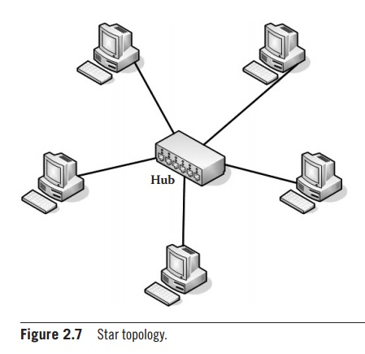
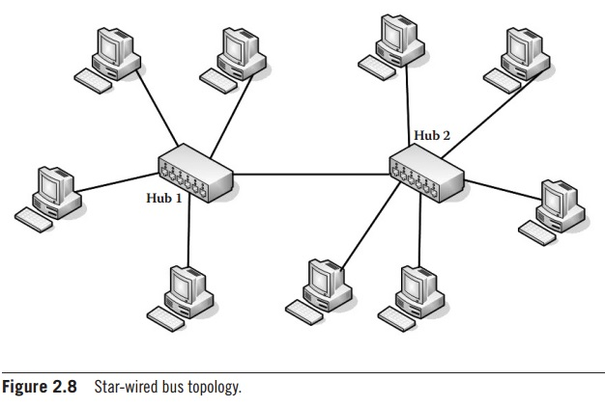
Figure Star and Star-wired bus topology
1.<number>
Notes:
1.#

Slide 22
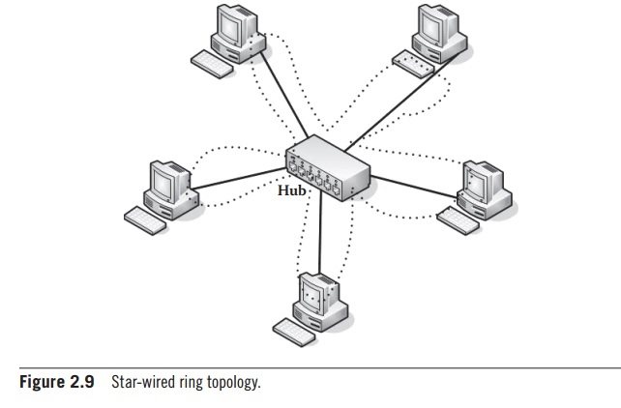
Figure Star-wired ring topology
The star-wired ring topology physically looks like the star topology. However, the diﬀerence is that the data ﬂow is in a
circular fashion like that in a ring. Hence, the logical topology works like a ring topology.
1.<number>
Notes:
1.#

Slide 23
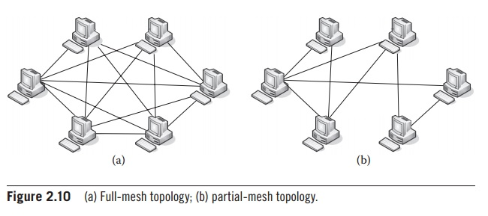
Figure Full-mesh and Partial-mesh topology
1.<number>
Notes:
1.#

Slide 24
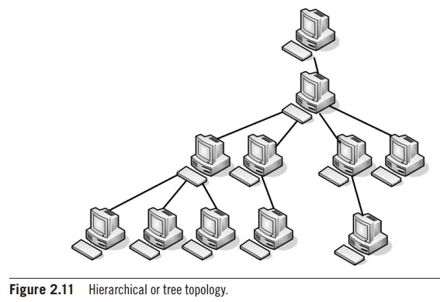
Figure Hierarchical or Tree topology
1.<number>
Notes:
1.#

Slide 25
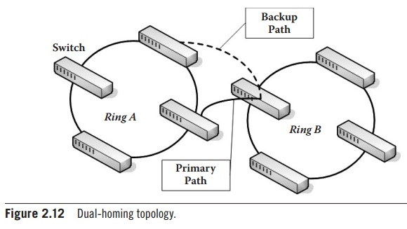
Figure Dual-homing topology
The dual-homing topology adds reliability by allowing a device to be connected to the network by way of two independent
connection points (points of attachment). One access point provides the operating connection; the other implements a
standby or backup connection activated in the event of operating connection failure.
1.<number>
Notes:
1.#

Slide 26
_x0010_Categories of Networks
Local Area Networks (LANs)
  Short distances
  Designed to provide local interconnectivity
Wide Area Networks (WANs)
  Long distances
  Provide connectivity over large areas
Metropolitan Area Networks (MANs)
  Provide connectivity over areas such as a city, a campus
1.<number>
Notes:
1.#

Slide 27

Figure 1.10 An isolated LAN connecting 12 computers to a hub in a closet
1.<number>
Notes:
1.#

Slide 28

Figure 1.11 WANs: a switched WAN and a point-to-point WAN
1.<number>
Notes:
1.#

Slide 29

Figure 1.12 A heterogeneous network made of four WANs and two LANs
1.<number>
Notes:
1.#

Slide 30
1-3 THE INTERNET
The Internet has revolutionized many aspects of our daily lives. It has affected the way we do business as well as the way we spend our leisure time. The Internet is a communication system that has brought a wealth of information to our fingertips and organized it for our use.
Topics discussed in this section:
Organization of the Internet
Internet Service Providers (ISPs)
1.<number>
Notes:
1.#

Slide 31

Figure 1.13 Hierarchical organization of the Internet
1.<number>
Notes:
1.#

Slide 32
1-4 PROTOCOLS
A protocol is synonymous with rule. It consists of a set of rules that govern data communications. It determines what is communicated, how it is communicated and when it is communicated. The key elements of a protocol are syntax, semantics and timing
Topics discussed in this section:
Syntax
Semantics
Timing
1.<number>
Notes:
1.#

Slide 33
_x0010_Elements of a Protocol
Syntax
  Structure or format of the data
  Indicates how to read the bits - field delineation
Semantics
  Interprets the meaning of the bits
  Knows which fields define what action
Timing
  When data should be sent and what
  Speed at which data should be sent or speed at which it is being received.
1.<number>
Notes:
1.#

